Slide 1

SAMRAT ASHOK TECHNOLOGICAL INSTITUTE
VIDISHA (M.P)
MINOR PROJECT – HAND GESTURE VOLUME CONTROLLER
Presented to :-
Prof. ABHISHEK MATHUR Sir
Presented by :-
Ayush Dhabale – 0108CS201022
Himanshu Kudesiya – 0108CS201041
Hitika Gahlot – 0108CS201042
Jaiansh Bora – 0108CS201043
Nilima Barde – 0108CS201071

Slide 2
CONTENT
Introduction
Working Principle
Approach
Tools and Technologies
Experimentation
Advantages
Future Scope

Slide 3
INTRODUCTION
Gesture volume control is a modern technology that allows users to adjust the volume of their devices without the need for physical buttons or touchscreens.
The objective of this project is to develop an interface which will capture human hand gesture dynamically and will control the volume level.
The human body’s motions are read by computer camera. The computer then makes use of this data as input to handle applications.

Slide 4
WORKING PRINCIPLE
The camera in our device is used for this project. It detects our hand landmarks which are the points on our hand.
The camera detects the position, movement, and distance of the user's hand or fingers and convert this information into data that can be interpreted by the machine learning algorithms.
We will be using two landmarks that are index finger tip and thumb tip (4 and 8 respectively).
The distance between the points 4 and 8 will be directly proportional to the volume of device.

Slide 5
APPROACH
Detect hand landmarks.
Calculate the distance between thumb tip and index finger tip.
Map the distance of thumb tip and index finger tip with volume range. Generally , distance between thumb tip and index finger tip is within the range of 30 – 350 and the volume range is from -63.5 – 0.0.
In order to exit click ‘Close Button‘.

Slide 6
TOOLS AND TECHNOLOGY
Framework – Mediapipe
Libraries –
CV2
Mediapipe
Pycaw (AudioUtilities, IAudioEndpointVolume)
Time
Numpy
Math
Tool – Visual Studio Code

Slide 7
CV2
CV2 (OpenCV) volume gesture control is an application of the OpenCV library to detect and interpret hand gestures made by users for controlling the volume of audio and video systems.
This technology uses computer vision algorithms to capture and analyze the movements of the user's hand, and translate them into volume control commands.
The hand gestures are recognized and interpreted by the CV2 volume gesture control system.

Slide 8
MEDIAPIPE
Mediapipe is an open-source machine learning library of Google, which has some solutions for face recognition and gesture recognition, and provides encapsulation of python, js and other languages.
Developers can use the framework's pre-built hand tracking and gesture recognition models, or build their own custom models using MediaPipe's ML training and inference tools.
They can also leverage MediaPipe's integration with other technologies such as OpenCV.

Slide 9
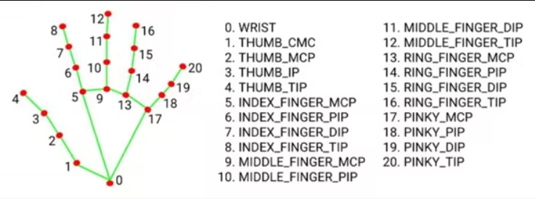
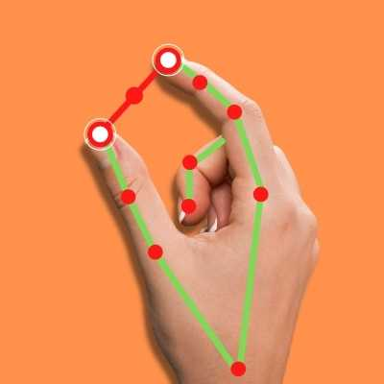
MediaPipe Hands is a high-fidelity hand and finger tracking solution. It uses machine learning (ML) to infer 21 key 3D hand information from just one frame. We can use it to extract the coordinates of the key points of the hand.

Slide 10
Pycaw
PyCAW (Python Core Audio Windows) is a Python library that provides an interface to the Windows Core Audio API.
In volume gesture control, PyCAW can be used to adjust the volume of the audio system in response to the hand gestures made by the user.
Once the hand gestures are recognized and interpreted by the gesture recognition algorithm, PyCAW can be used to set the volume levels of the audio device accordingly.

Slide 11
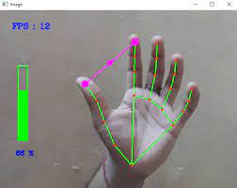
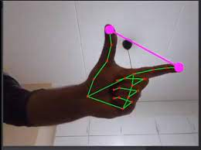
EXPERIMENTATION
The camera is detecting the points and drawing the lines or making the landmarks.
The pink line is between the landmark of index finger tip and thumb tip (Point 4 and 8).

Slide 12
ADVANTAGES
Easy to use
Hassle free
Fun to use
More interactivity
Intuitive and natural
Hands-free operation
Accessibility
Convenience
Aesthetics

Slide 13
FUTURE SCOPE
Computer interaction is one of the significant challenges that elderly and disabled people face in today's computerized world. In recent years, hand gesture recognition has emerged as one of the most natural human-machine interactions in software development, particularly for facilitating friendly and flexible human-computer interaction.
Integration with smart home devices
Virtual and augmented reality
Wearable devices
Health monitoring

Slide 14
THANK YOU

